Slide 1



Analyze the behavior of loan property customers
Favian Sis Bagus Febrianto
Favian Sis Bagus
https://github.com/Favian92

Slide 2
Overview
As a data analyst at a bank that provides loan services for property purchases, the customers of this program are existing bank account holders. The data includes all personal information of the customers as well as their credit history within a specific period. My task is to analyze the behavior of customers who apply for loans at the bank.

Slide 3
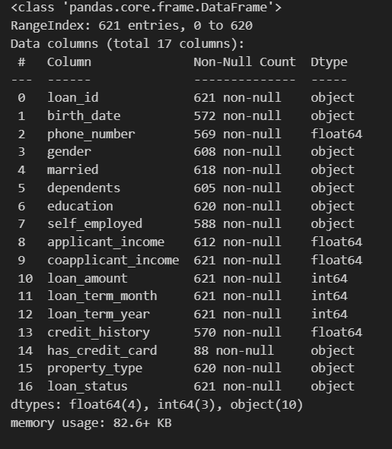
Dataset
There are many columns that contain the data of customers who wish to apply for a loan.

Slide 4

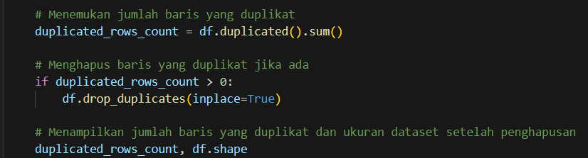
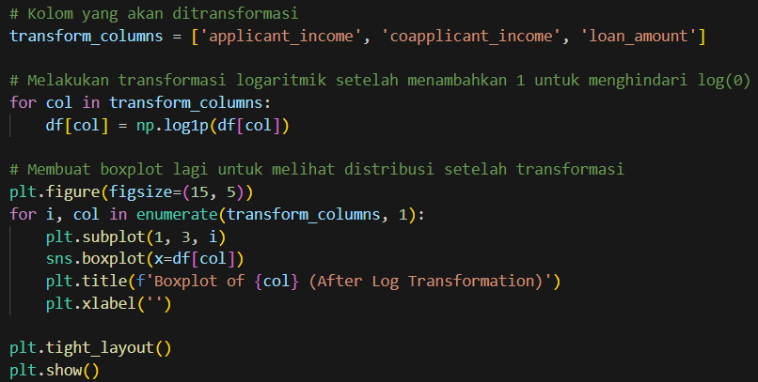
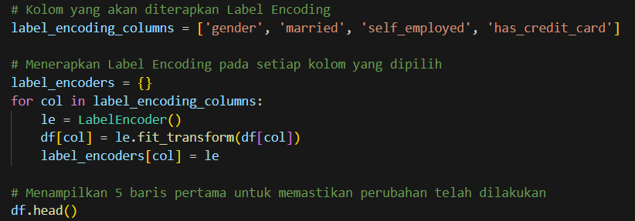
Data Exploratory
Handling Missing Values
Handling Duplicated Data
Handling Outliers
Feature Encoding
I dealt with missing values by removing columns with many null values and filling in other values when the number of empty rows was not significant..
I searched for duplicate data and found five duplicate entries, which I then removed.
Some outliers were identified, so I performed filtering to reduce the number of outliers.
I defined the columns for gender, married, dependents, education, self_employed, and property_type with specific options to facilitate visualization.

Slide 5
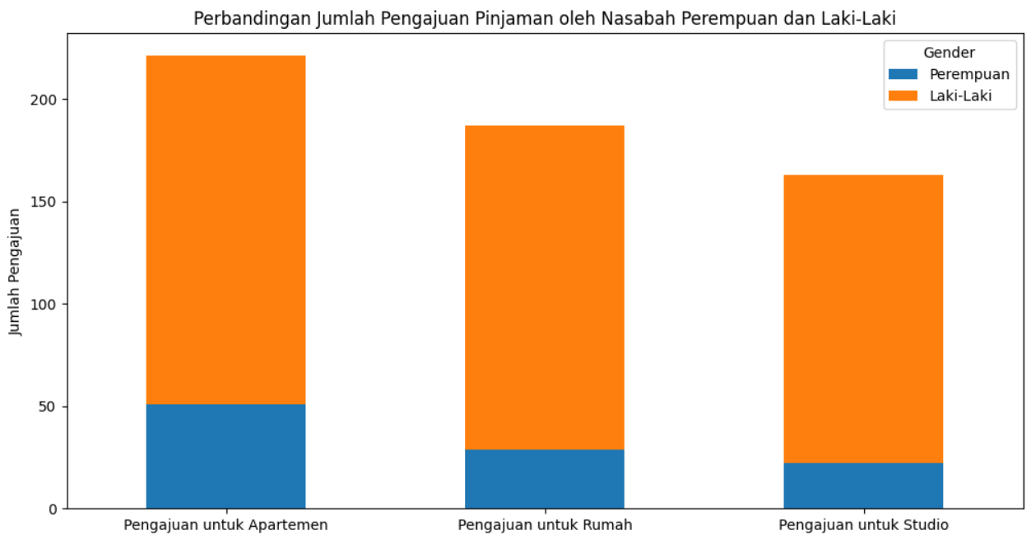
Business Insight
Apartments are the preferred property choice for both male and female customers, followed by houses, and the least preferred property by customers is studios.
Apartment
House
Studio
Male : 114
Female : 34
Total : 148
Male : 98
Female : 16
Total : 114
Male : 87
Female : 17
Total : 104
Untuk selengkapnya, dapat melihat jupyter notebook disini

Slide 6
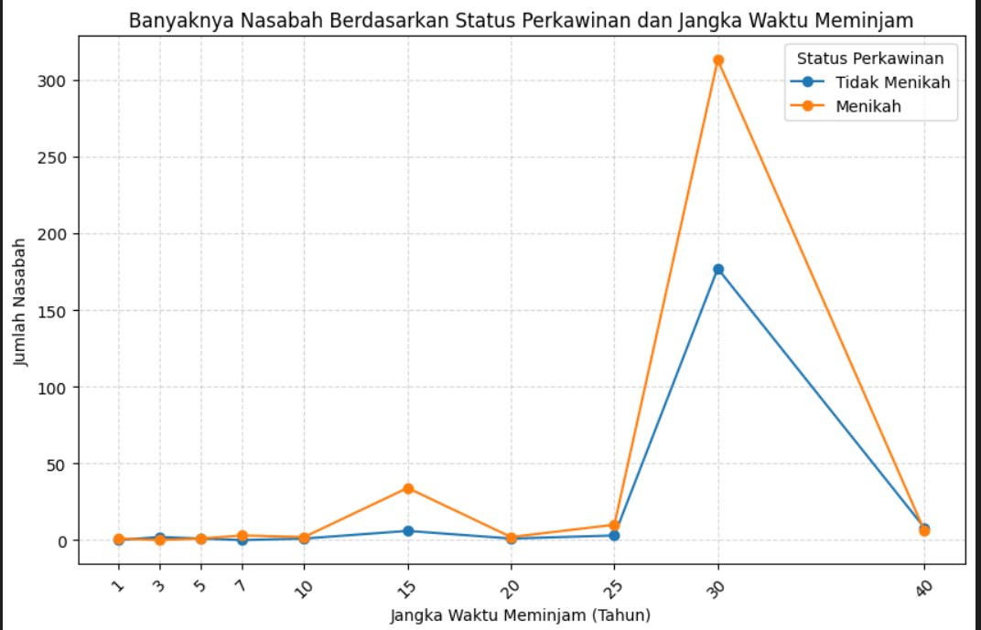
Business Insight
Loan Term
Looking at the data, most customers choose a credit term of 30 years, whether they are married or unmarried, because at that time it is likely to align with the customers' economic
capabilities.
Untuk selengkapnya, dapat melihat jupyter notebook disini

Slide 7
Business Recomendation
Based on the observations conducted, it can be concluded that the behavior of the majority of customers is male with an average age of >30 years, married status, and the majority of them choose a credit term of 30 years. This is likely because married individuals require credit for daily living expenses such as housing compared to unmarried individuals.

Slide 8
Business Recomendation
THANK YOU

